Slide 1


Assignment 2 Corona Pandemic in Europe
Rasmus Eliasson & Oskar flodin
1

Slide 2
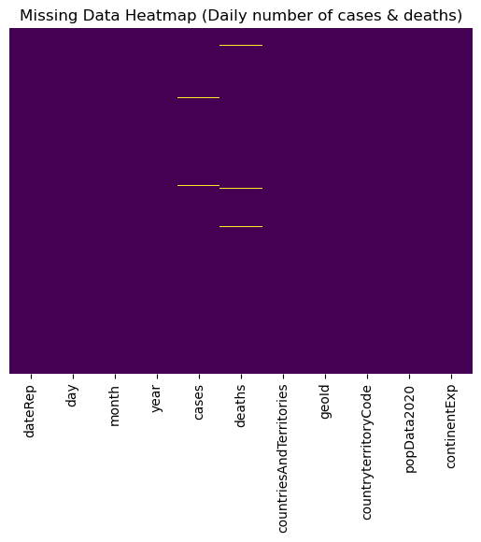
Dataset 1: Daily new cases and deaths
Outliers identified:
573 cases
966 Deaths
+ Nulls
No duplicates
Logarithmic
grouping
IQR
Rolling mean
2

Slide 3
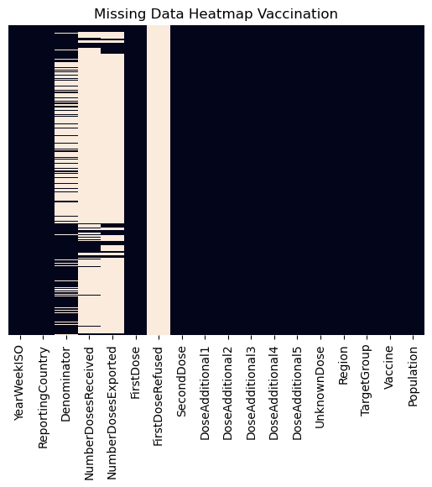
Dataset 2: Vaccination!
Grouping on:
Country
YearWeek
Vaccine
A lot of overlapping values between instances
Classify in 4 groups:
- Child (<18)
- Adult (18-59)
- Senior (60<)
- Unkown
Example:
Child <18 =
Age0_4,
Age5_9,
Age10_14,
Age15_17
3

Slide 4
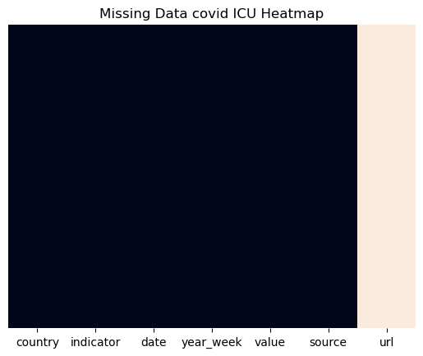
Dataset 3: Hospitalization and ICU
Same approach as dataset 1
Amount of outliers:
"weekly admissions": 150
"weekly ICU admissions": 147
"daily ICU occupancy": 380
"daily hospital occupancy": 449
4

Slide 5
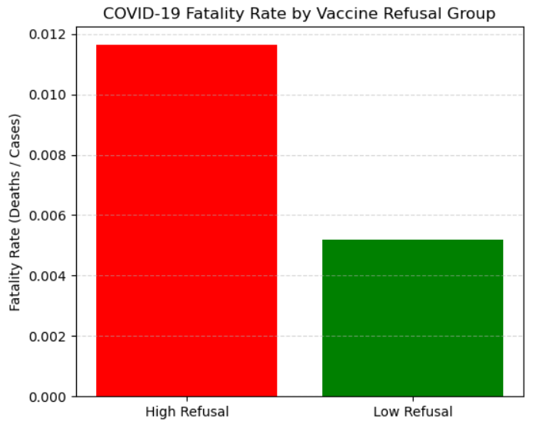
How was fatality rate between high and low vaccine refusal countries?
Hypothesis Test: α = 0.05 significance level
H₀: No difference in fatality rates between high and low vaccine refusal groups.
H₁: There is a difference in fatality rates between high and low vaccine refusal groups.
T-statistic: 2.416, P-value: 0.03
Reject the null hypothesis:
There is a statistically significant difference in fatality rates between the high and low vaccine refusal groups.
1.18%
0.51%
2 doses per person = Low refusal
Further investigation would be to compare how the vaccination rates affected the cases and healthcare impact from ICU patients.
5

Slide 6
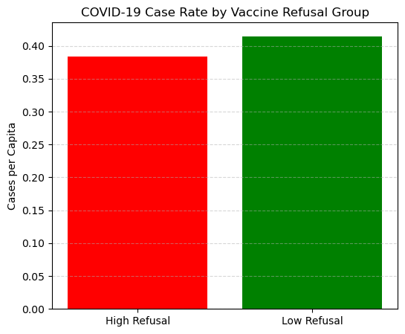
How effective was vaccination in mitigating spread & reducing ICU utilization?
H₀: No difference in case rates between high and low vaccine refusal groups.
H₁: There is a difference in case rates between high and low vaccine refusal groups.
Fail to reject the null hypothesis:
->No statistically significant difference in fatality rates between high and low vaccine refusal groups. T-statistic: -0.564, P-value: 0.5789
38.42%
41.48%
6

Slide 7
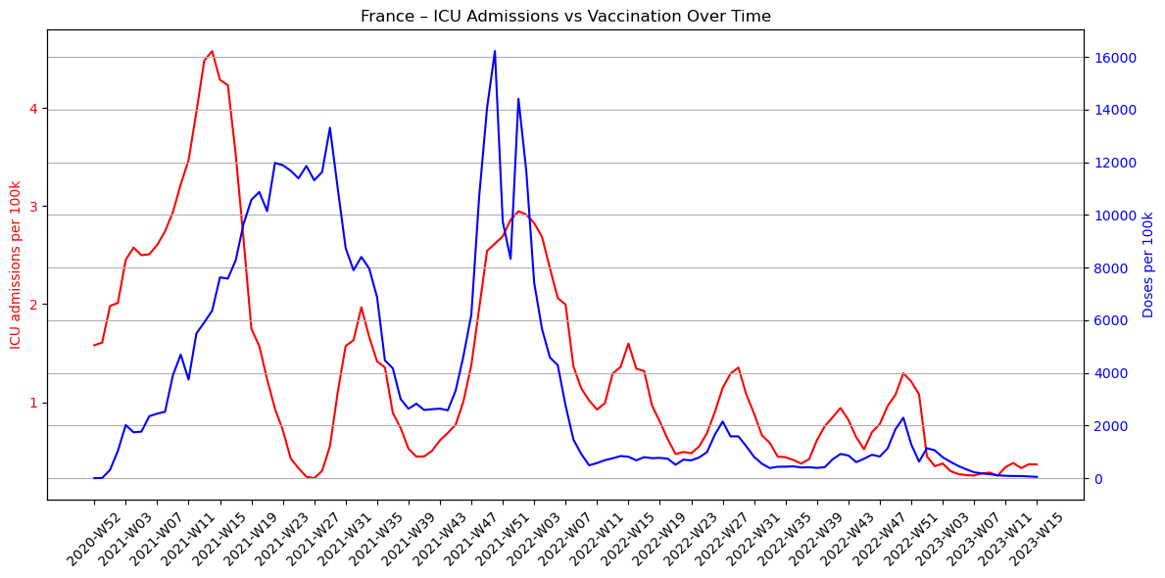
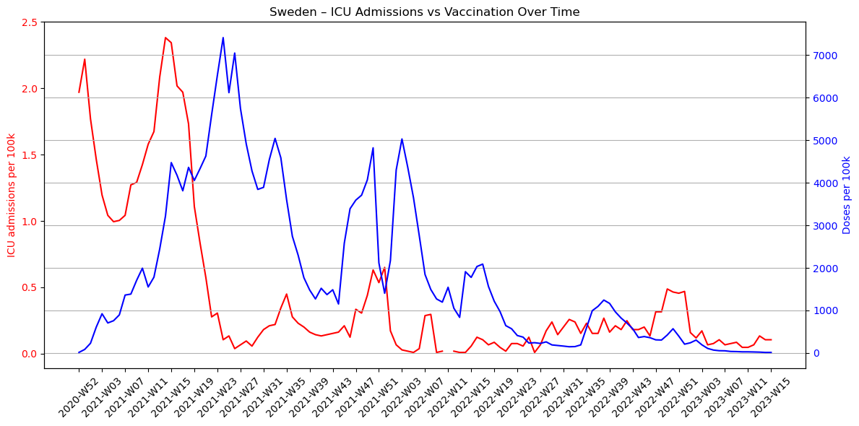
How effective was vaccination in mitigating spread & reducing ICU utilization?
7

Slide 8
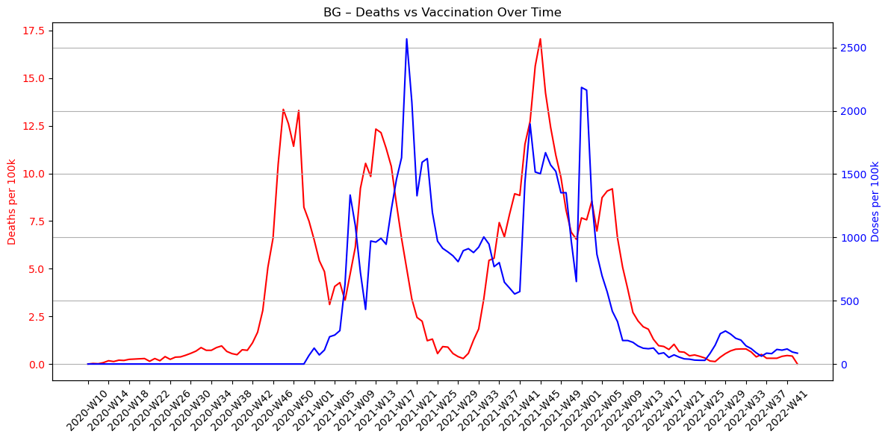
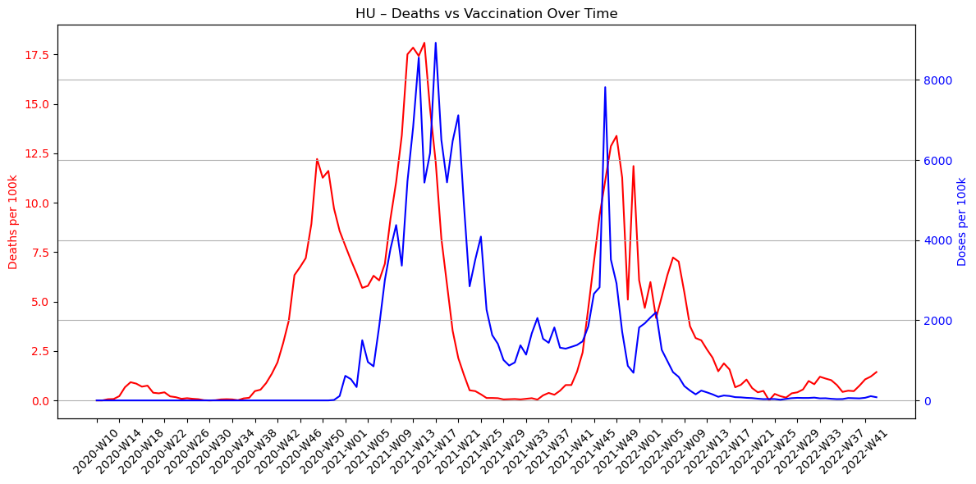
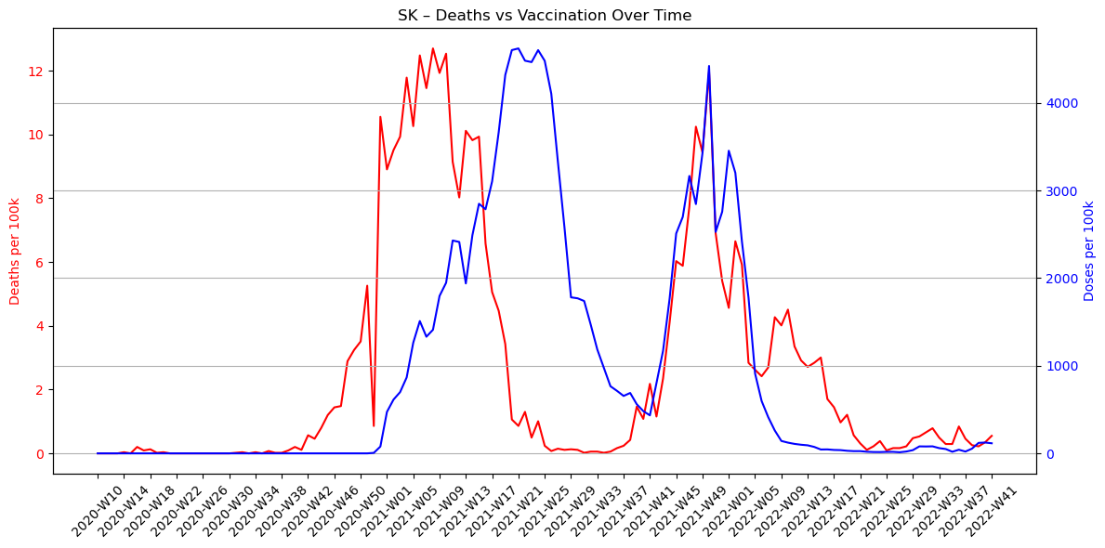
Did some countries experience a continuous increase in daily COVID-19 deaths, despite increased vaccination coverage?
8

Slide 9
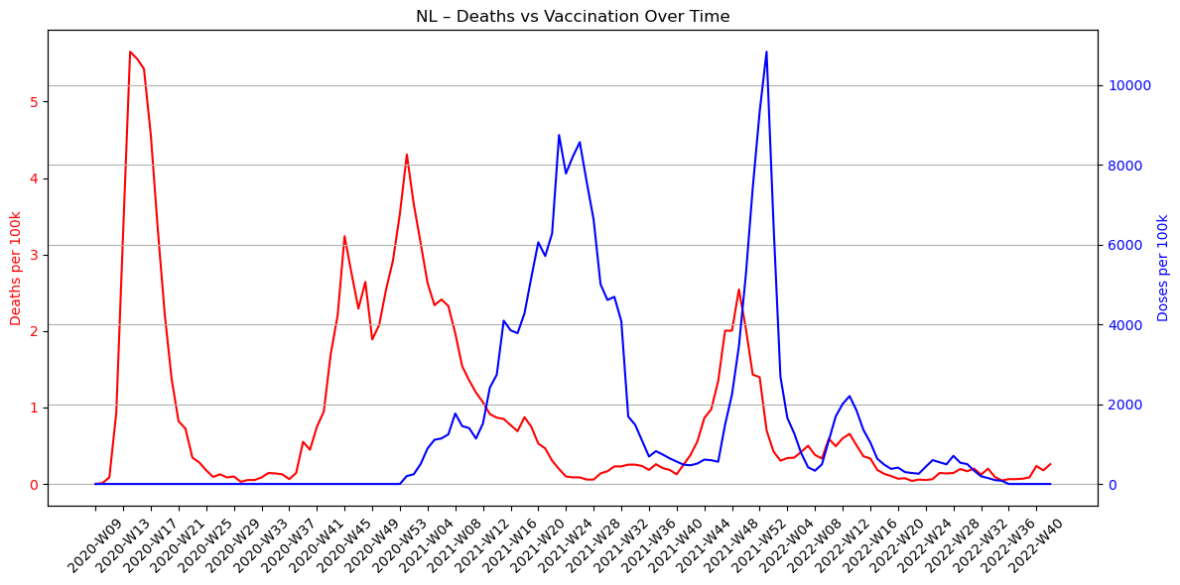
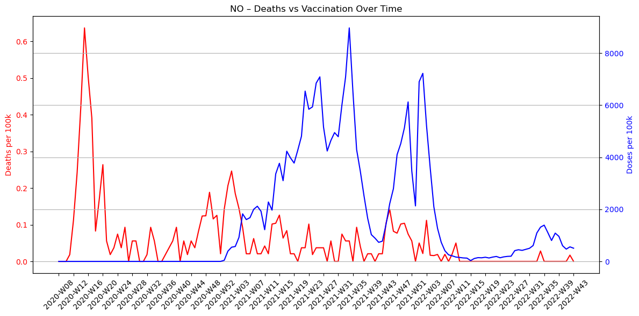
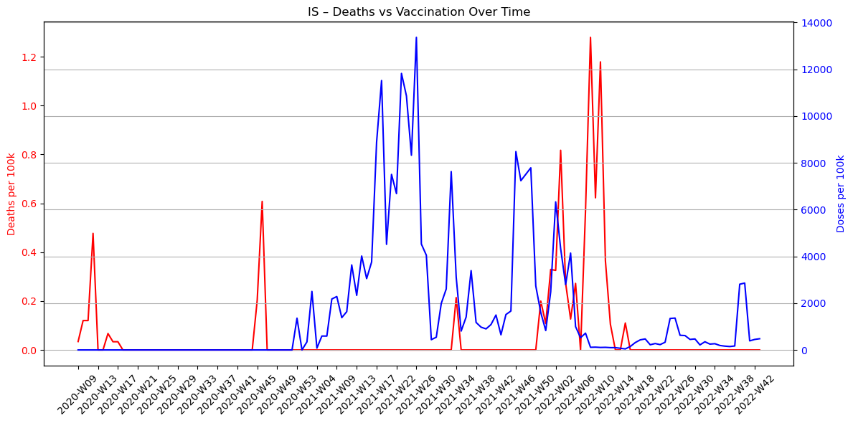
Did some countries experience a continuous increase in daily COVID-19 deaths, despite increased vaccination coverage?
9

Slide 10
Spearman correlation test
H₀: There is no statistically significant correlation between vaccination coverage and deaths per 100,000.
H₁: There is a statistically significant correlation between vaccination coverage and deaths per 100,000.
Bulgaria:
Spearman correlation = 0.56, p = 0.0000
→ The result is statistically significant. We reject H₀.
Interpretation: A positive correlation – deaths increased as vaccination coverage increased.
Island:
Spearman correlation = -0.01, p = 0.9249
→ The result is not statistically significant. We fail to reject H₀.
10

Slide 11
Conclusion
Countries with higher vaccine refusal rates experienced higher case fatality rates.
While testing data showed vaccines didn’t fully prevent spread or ICU admissions, visual trends indicated a reduction in ICU cases over time with rising vaccination.
Vaccines alone were often not sufficient to reduce death rates — strong general healthcare systems played a critical supporting role.
Ironically, countries most sceptical of vaccines and with weaker healthcare infrastructure were the ones that needed vaccination the most.
11

